Slide 1
Specialist High Skills Major (SHSM)
Pierre Elliott Trudeau
Notes:
Thanks Jovia, Taha and Aasiya!!!! :) - dede

Slide 2

Arts & Culture, Business and Health & Wellness

Slide 3
What is SHSM?
SHSM lets students focus on a career path that matches their skills and interests while meeting the requirements of the Ontario Secondary School Diploma (OSSD)

Slide 4
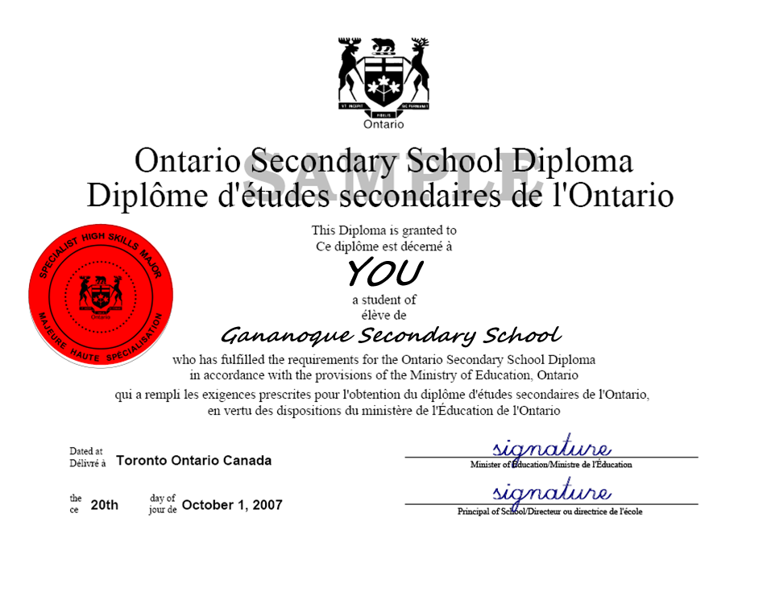

Slide 5
5 parts of SHSM:
A bundle of 8-10 Grade 11 and Grade 12 credits
“Reach ahead” experiences in the student’s pathway of choice (ex. University and College visits…)
Certifications and training courses (ex. CPR/First Aid, leadership, training in a technique…)
Experiential learning activities (ex. Competitions, discussion panels…)
SPCC (Sector Partner Contextualized Content): I.C.E. Training
All free of charge!

Slide 6
Additional advantages
SHSM recognition on your OSSD (Red Seal and list of certificates)
University awards (This list is expanding each year!)
  $500 SHSM Entrance Award at University of Guelph-Humber
  $500 Lakehead University SHSM Award Lakehead University
  $2,000 St. Mary’s University in Nova Scotia
  $1,000 OAC Specialist High Skills Major Program Scholarships at Guelph

Slide 7
Co-operative Education (co-op)
Mandatory component of SHSM
  Grade 11 (highly recommended) or 12
Work in your field of interest in all pathways (apprenticeship, college, university, workplace)
Earn 2 to 4 high school elective credits
Enhances effective job searching skills

Slide 8
What would my schedule look like?! (co-op)
2 credits = 2 periods (AM or PM)
4 credits = 4 periods (full day)
Dependent on placement,

Slide 9
OUR CO-OP EXPERIENCES

Slide 10
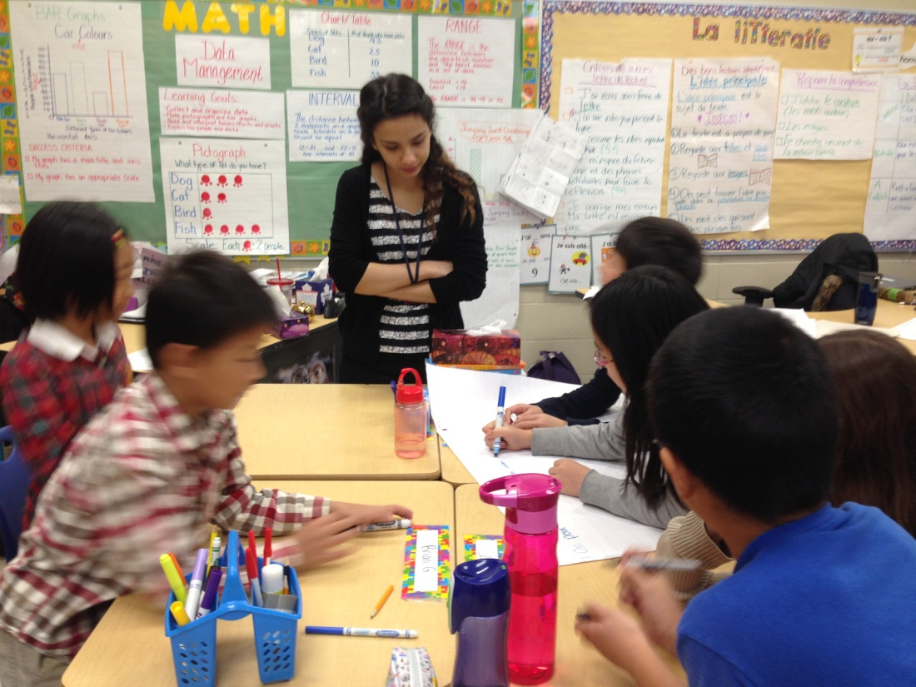

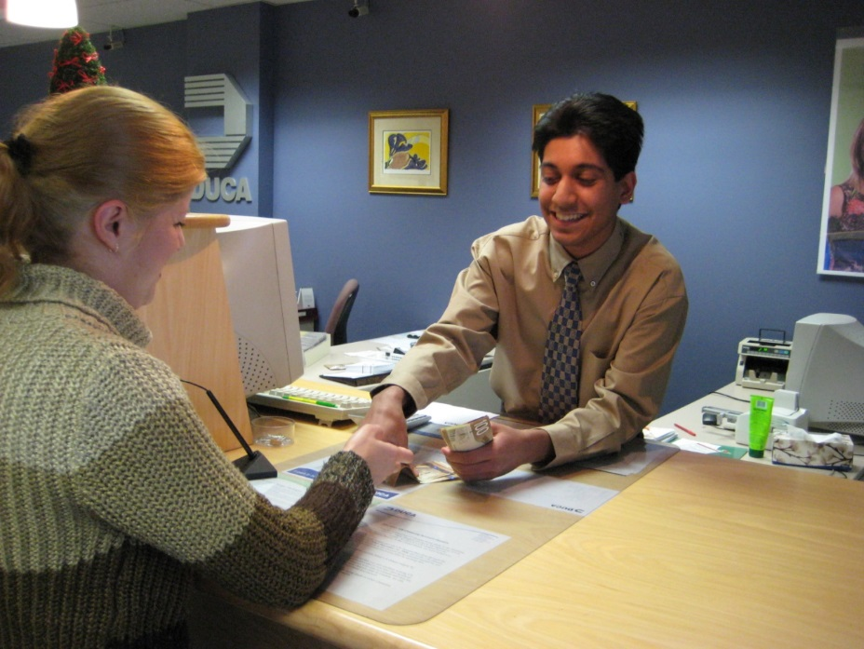
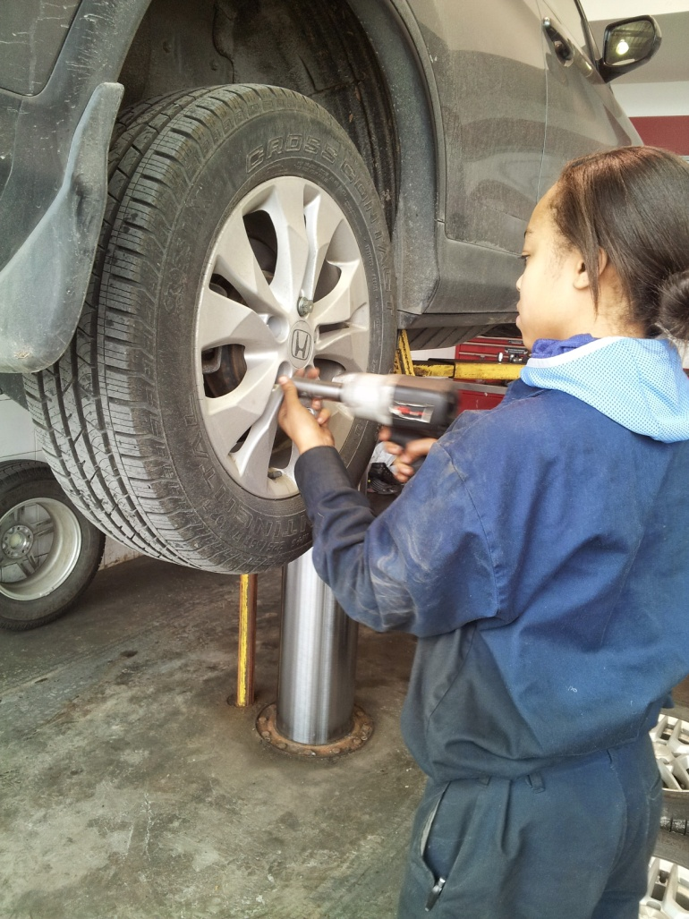
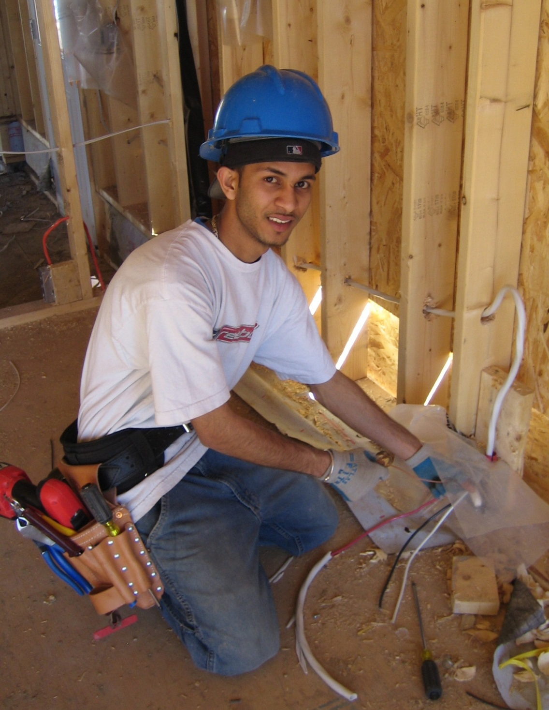
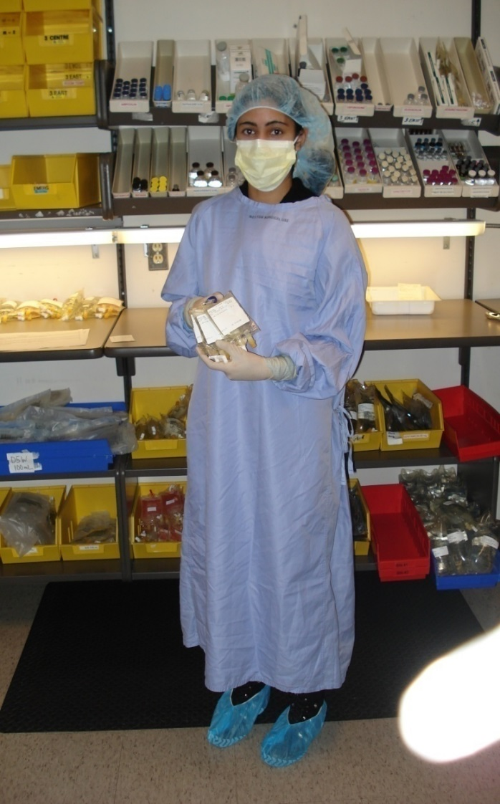

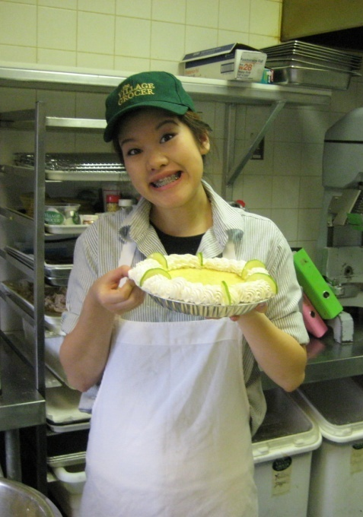

Slide 11
Next steps
Register as a SHSM student during course selection
Select co-op on career cruising to show your commitment to the program

Slide 12
Stay connected!
Twitter @pethsSHSM
Facebook @ PETHS Specialist High Skills Major

